Slide 1
Machine Learning
Classification and Regression

Slide 2
Heart failure prediction
Dataset: https://www.kaggle.com/andrewmvd/heart-failure-clinical-data?fbclid=IwAR2l8MikAl9a0a_LiZqlyBa11E8VFxw7xgd9_m8NwwzprLtXDDJgx-UhcUc

Slide 3
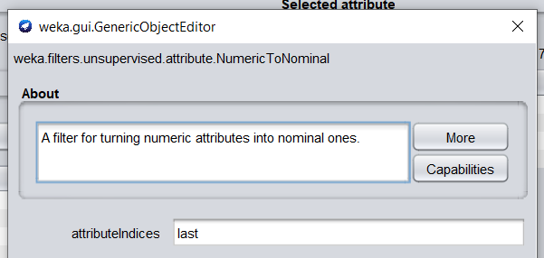
Data preprocessing
NumericToNominal for attribute DEATH_EVENT

Slide 4
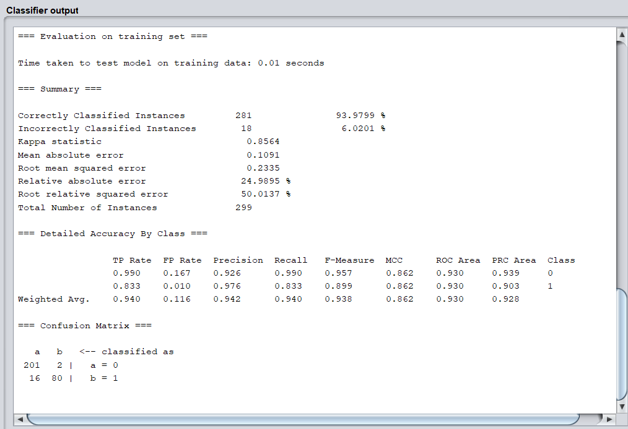
trees.J48 Classifier output

Slide 5
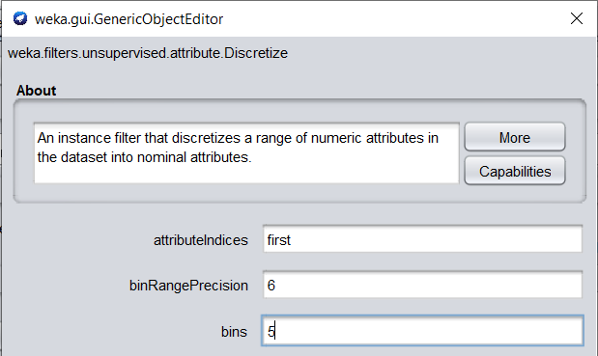
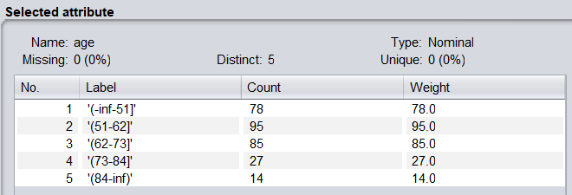
Data preprocessing
Discretize age in 5,10,15 bins

Slide 6
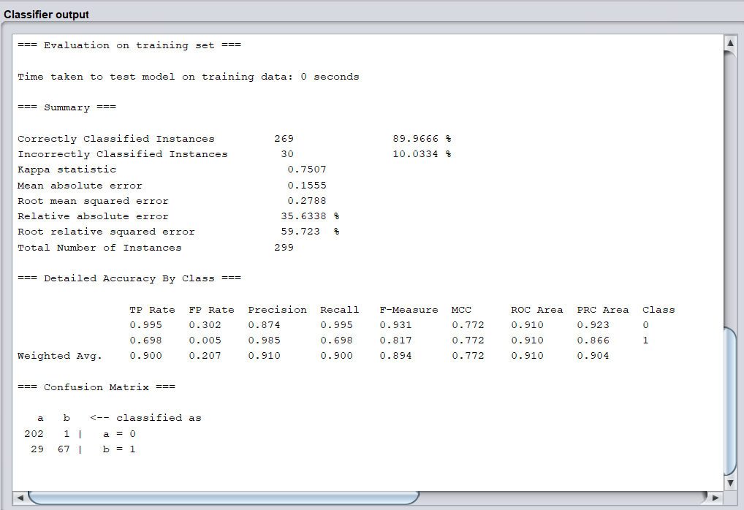
trees.J48 Classifier output
Age 10 bins

Slide 7
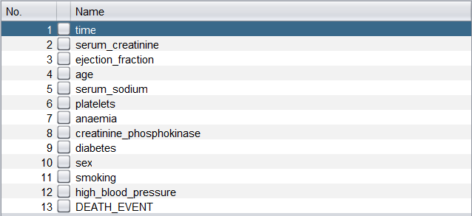
Select features with Weka Attribute Selector

Slide 8
Select features with Weka Attribute Selector

Slide 9
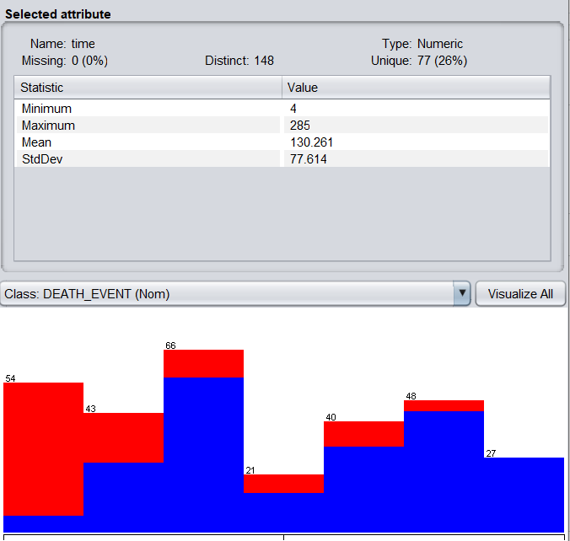

Slide 10
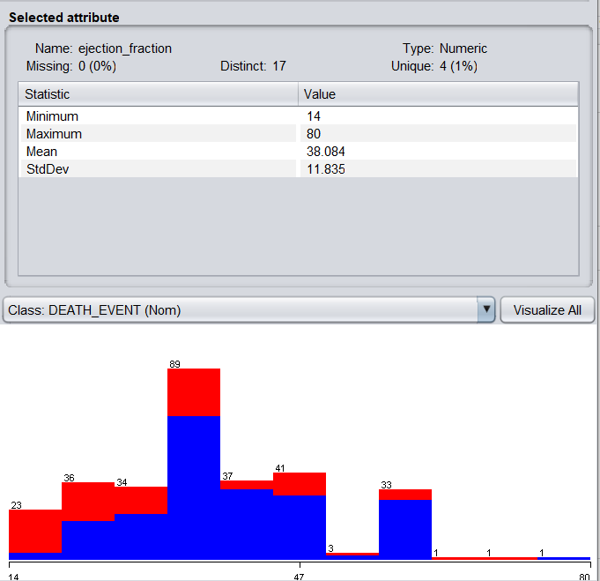

Slide 11
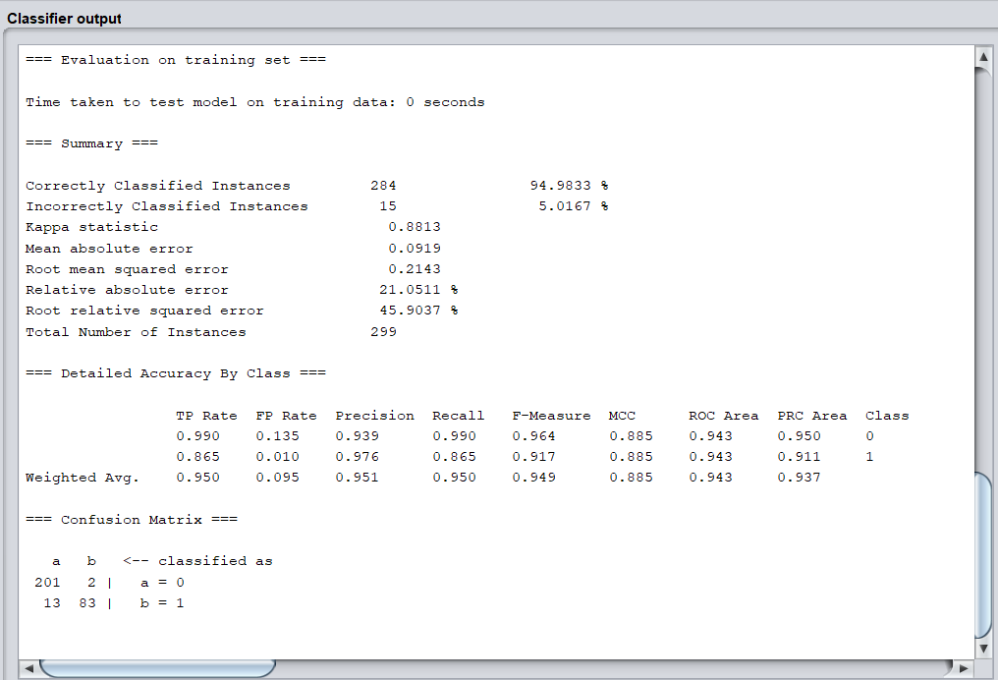
trees.J48 Classifier output
Best result

Slide 12
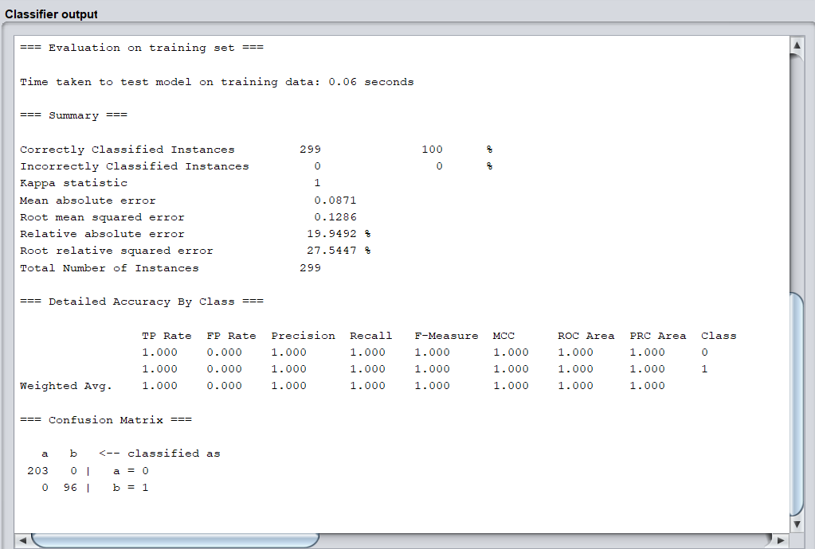
Random Forest Classifier output

Slide 13
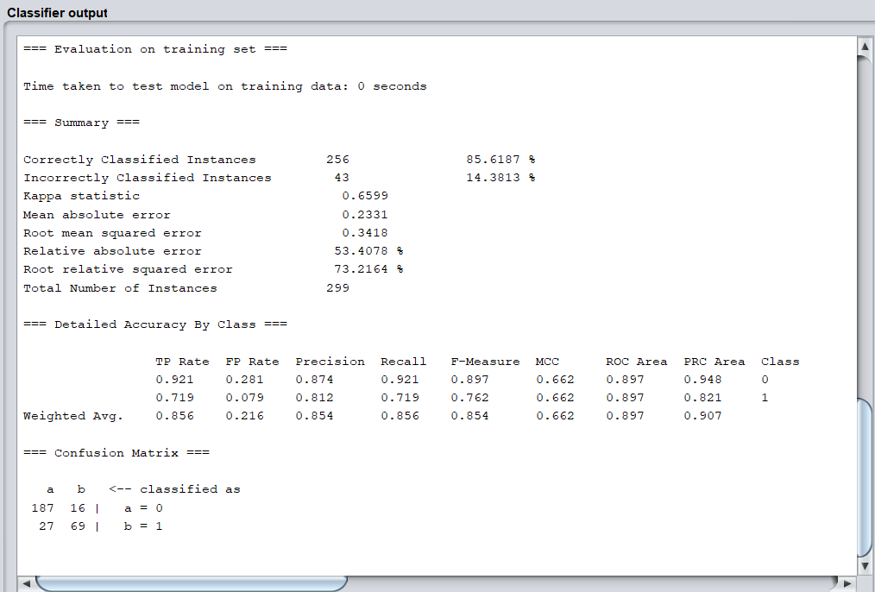
Logistic Classifier output

Slide 14
Car Price Prediction
Dataset: https://www.kaggle.com/nehalbirla/vehicle-dataset-from-cardekho

Slide 15
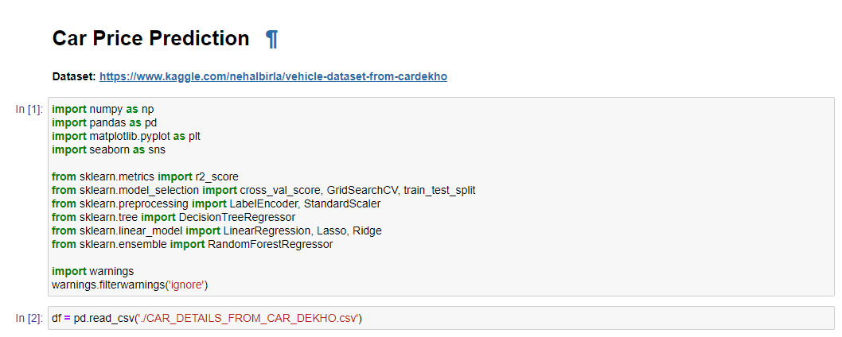

Slide 16
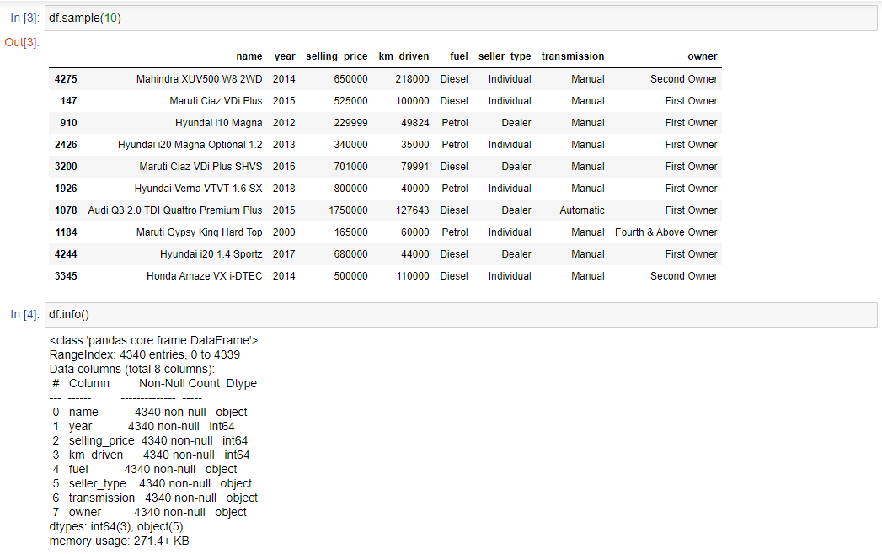

Slide 17
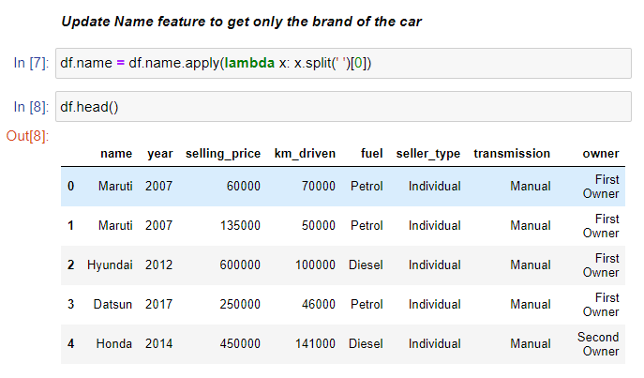

Slide 18
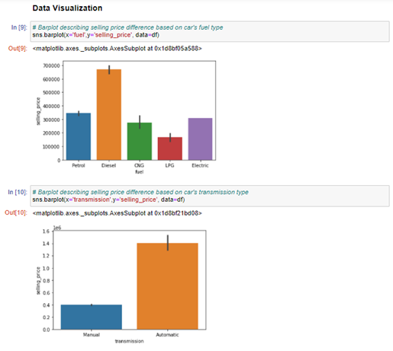
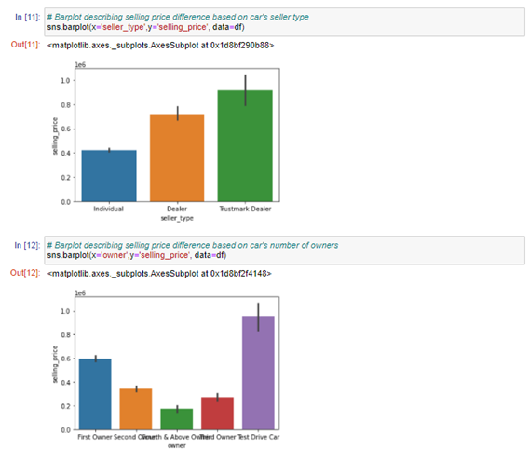

Slide 19
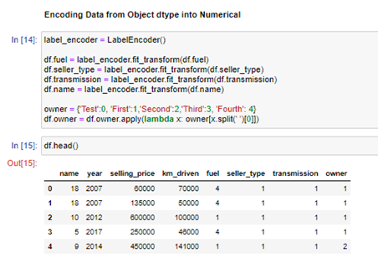
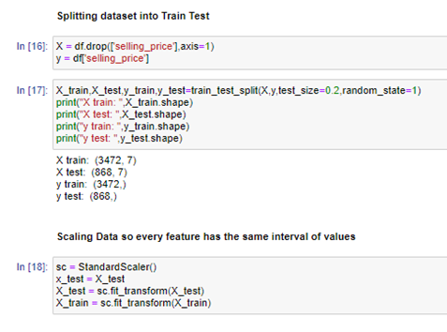

Slide 20
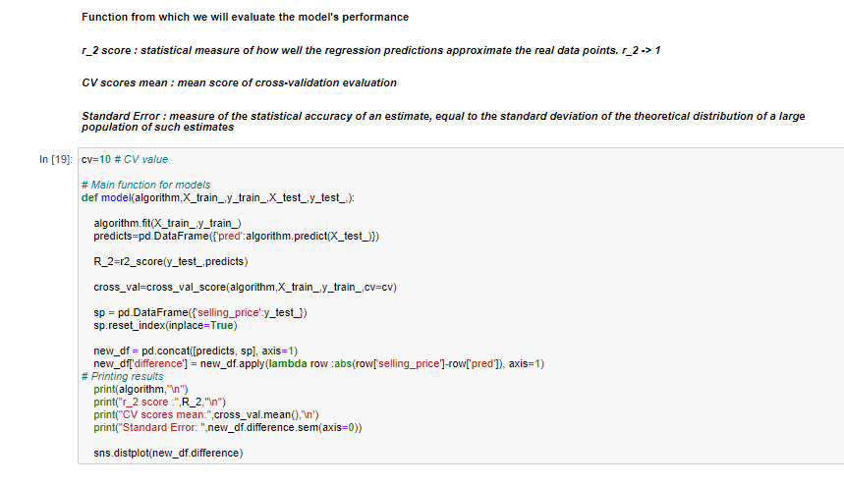

Slide 21
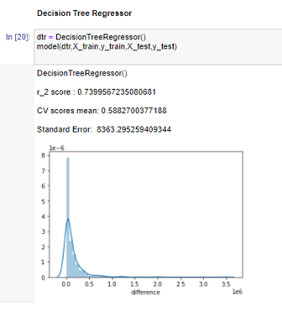
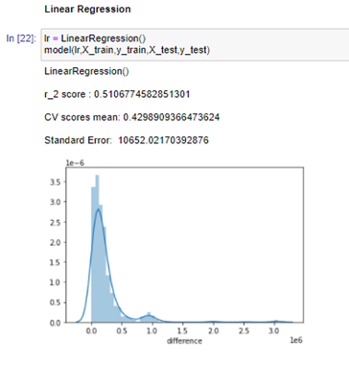
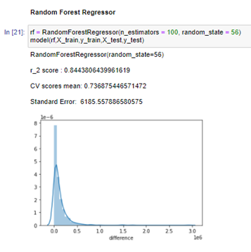

Slide 22
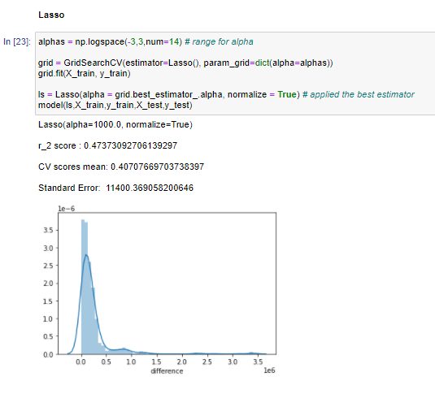
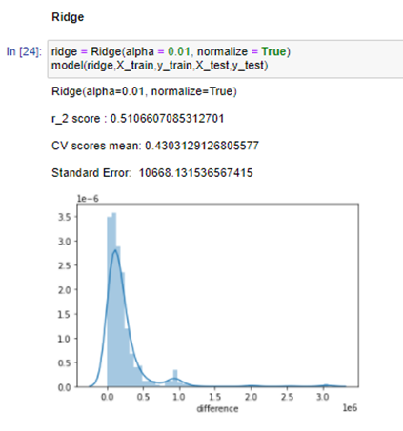

Slide 23
Heart Disease Prediction
Dataset: https://www.kaggle.com/ronitf/heart-disease-uci

Slide 24
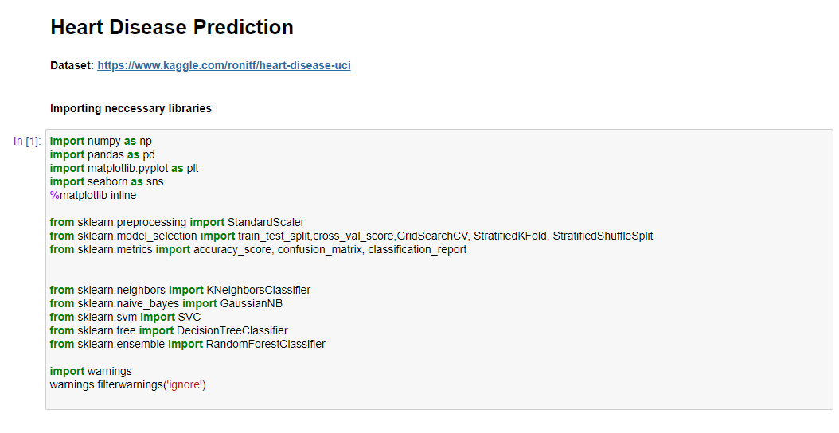

Slide 25
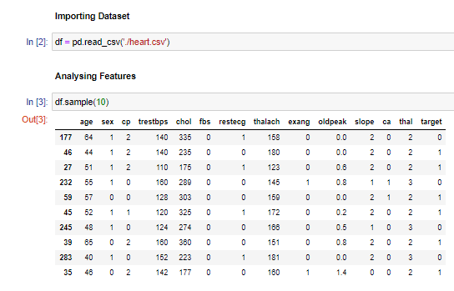
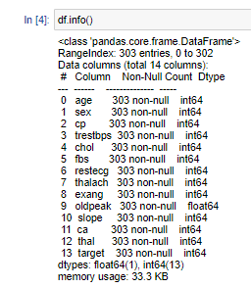

Slide 26
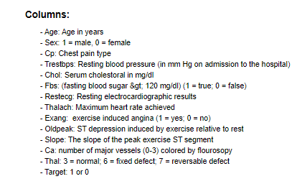

Slide 27
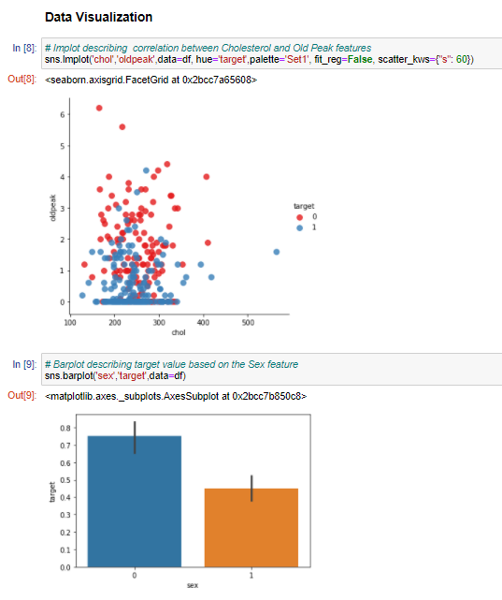
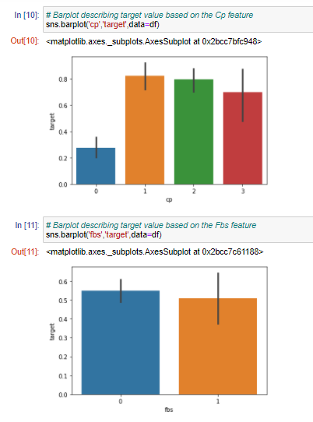

Slide 28
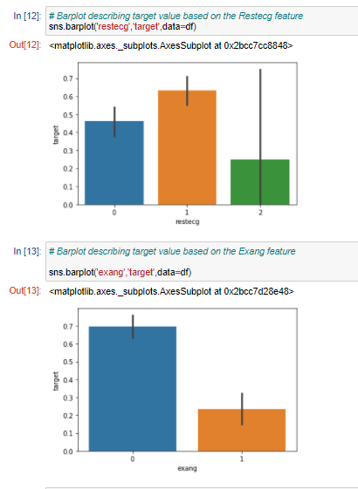
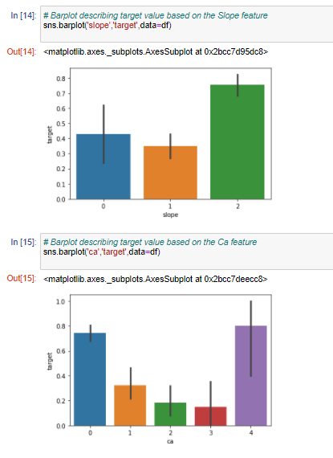

Slide 29
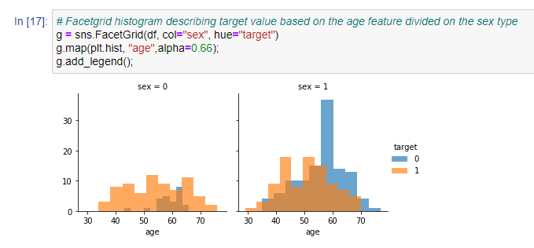
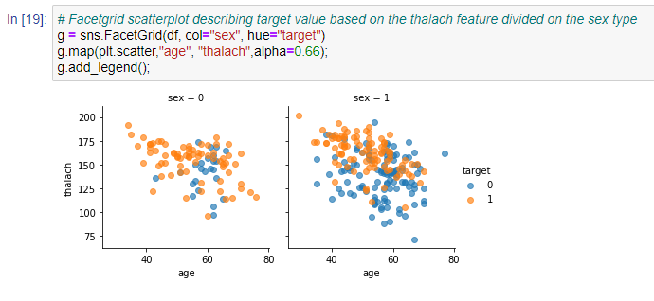

Slide 30
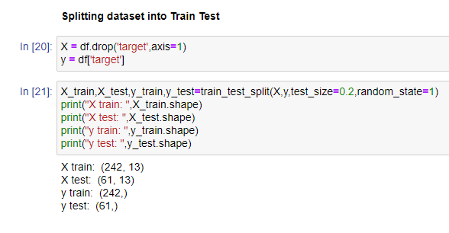
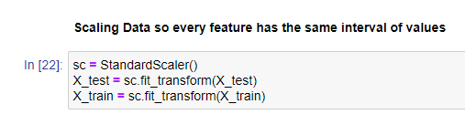

Slide 31
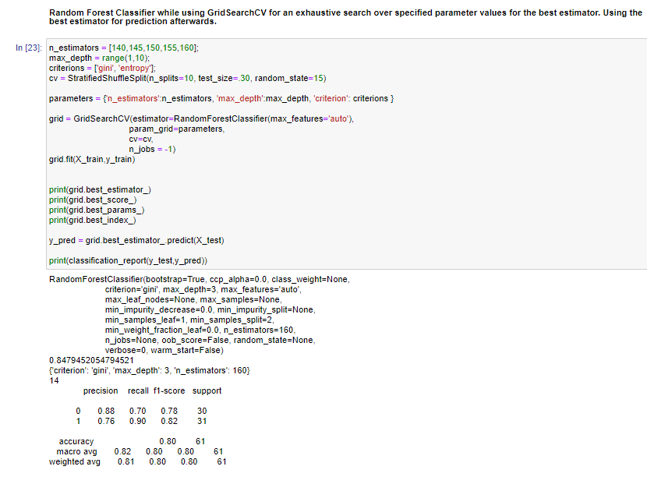

Slide 32
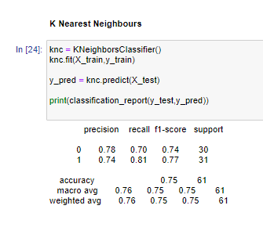
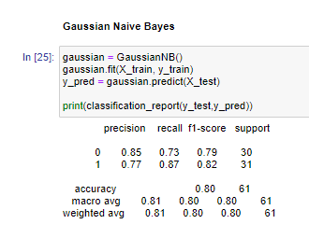
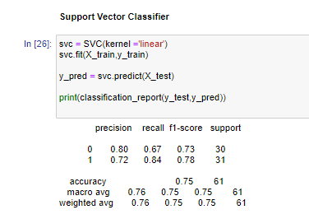

Slide 33
Job Posting Authenticity
Dataset: https://www.kaggle.com/shivamb/notebook
Number of features:
Number of rows:

Slide 34
Feature Descriptions
Features:
Fraudility (boolean) - Posting is genuine or fake

Slide 35
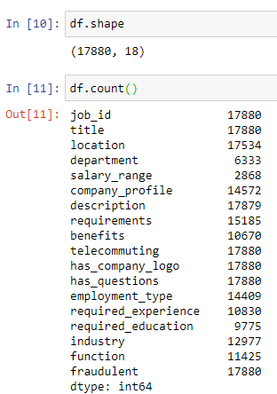
Exploring dataset

Slide 36
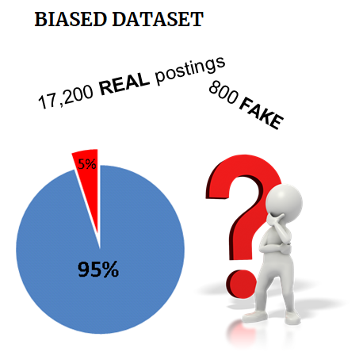
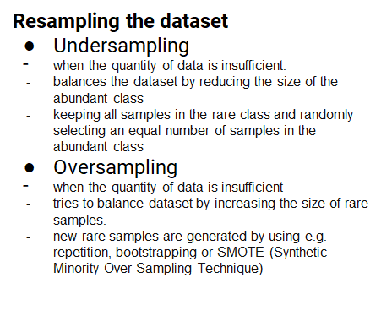
Challenge

Slide 37
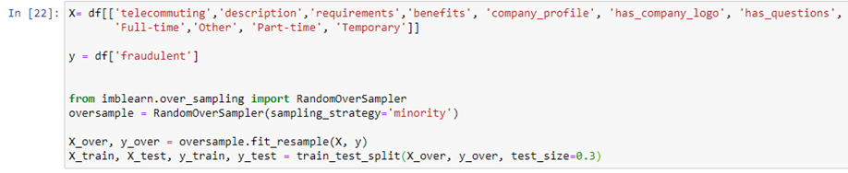
Oversampling implementation

Slide 38
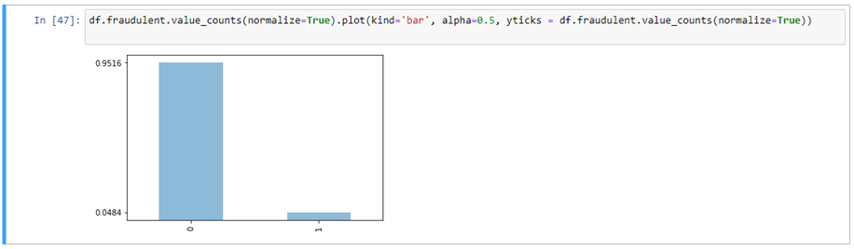
Observation of imbalanced data

Slide 39
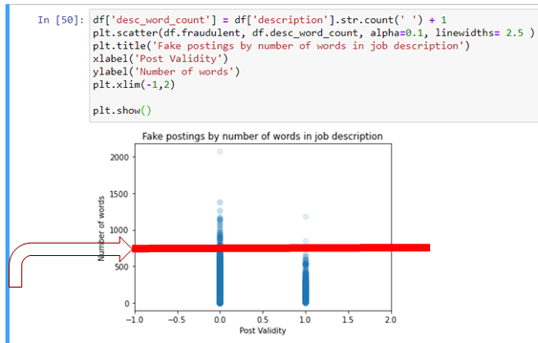
Fake job postings are more likely to have less words in the job description.. right?
The number of fraudulent job postings experiences a steep decrease in cases where the number of words in the job description is higher than
750.

Slide 40
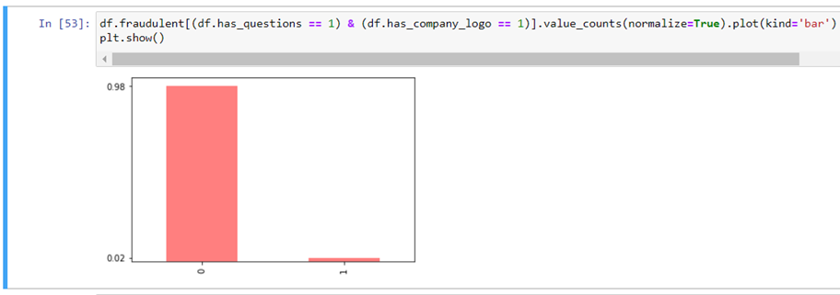
Real companies are more likely to have questions for you and a company logo.

Slide 41
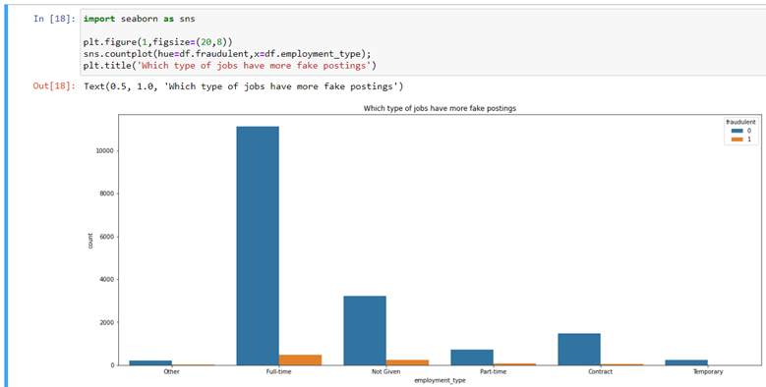
Postings grouped by employment type.

Slide 42
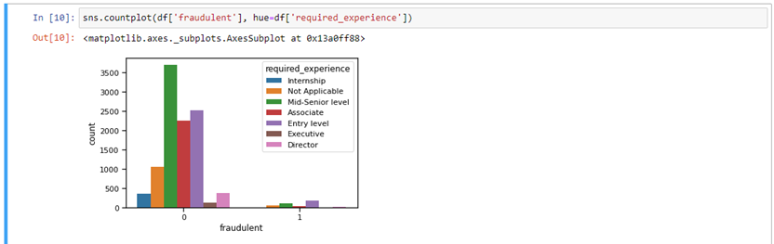
The trend based on required_experience feature.

Slide 43
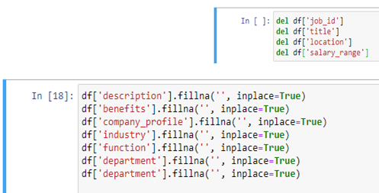
Data Preprocessing
Deletion of unnecessary features and filling missing data.

Slide 44

Data Preprocessing
Replace text fields with the length of the text for each of the following columns.

Slide 45


Slide 46


Predicting and results

Slide 47


Predicting and results

Slide 48
Student Grade Prediction
Dataset: https://www.kaggle.com/dipam7/student-grade-prediction

Slide 49


Data preprocessing
Turn Nominal Attributes into Binary Attributes
Scaling dataset values so every attribute have the same interval of values

Slide 50

Gaussian Processes output
Implements Gaussian processes for regression without hyperparameter-tuning
Batch Size : 100
Noise : 1
Kernel : PolyKernel
Seed : 1

Slide 51

Linear Regression output
Class for using linear regression for prediction.
Batch Size : 100
Ridge : 1.0E-8

Slide 52

SMOreg output
SMOreg implements the support vector machine for regression.
Batch Size : 100
c : 1
Kernel : PolyKernel

Slide 53

Multilayer Perceptron output
A classifier that uses backpropagation to learn a multi-layer perceptron to classify instances.
Batch Size : 100
Learning Rate : 0.03
Training Time : 1200

